Slide 1
Centralized Remote Agriculture Pump Control System for Farmers
K.R.Deeksha
P.Aleem
Y.Haritha
pheonix

Slide 2
Project Description
Integrating modern technologies in agriculture and irrigation management systems is one of the ways of enhancing the irrigation processes to optimize the use of water and electric power consumption.
The system however, depends on the timely application of the water required to meet the water needs of the crops and this is achieved by remote switching of water pumps.

Slide 3
We can develop a device through which we can control the pumps remotely. The device consists of buttons by pressing them we can switch on and switch off the water pumps.
This controlling device will be given to farmers for its farm lands so that the farmer who needs to control their pump can access that and control them. This system reduces the cost .

Slide 4
Project Highlights
Exploring the relay operations
Controlling the pumps through app
Integrating Relay with Pumps for switching it On and Off

Slide 5
Hardware
Nodemcu(esp8266)
Push Buttons
Relay

Slide 6
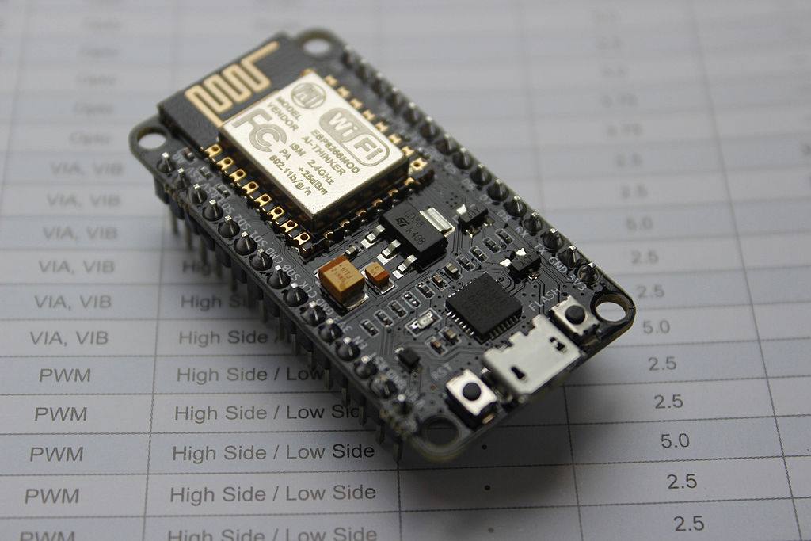
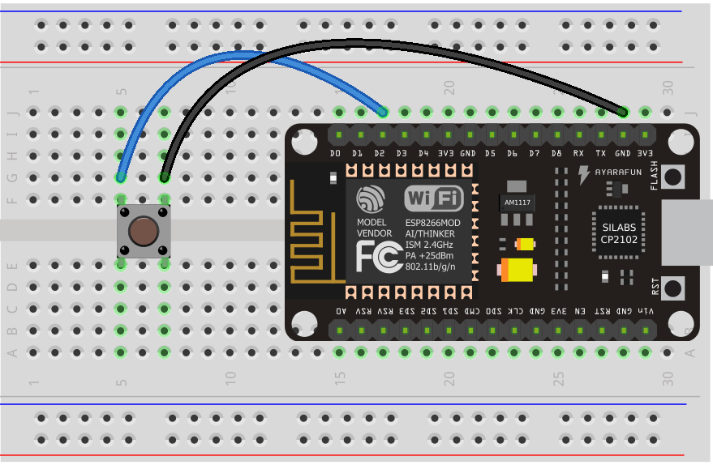
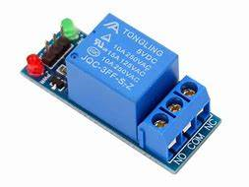
NODEMCU
NodeMCU is an open source IoT platform.It includes firmware which runs on the ESP8266 Wi-Fi SoC from Espressif Systems, and hardware which is based on the ESP-12 module. The firmware uses the Lua scripting language. It is based on the eLua project.
PushButton is a electronic component that connects two points in a circuit when you press it.
These Miniature Single Pole Single Throw (SPST) switches are breadboard friendly. Perfect as a tactile reset switch.
Relay is a electrically operated switch. Generally used relay modules are 5v / 12v.
The relay uses an electromagnet to mechanically switch electric appliances. It is operated by a relatively small electric current that can turn ON or OFF a much larger electric current.

Slide 7
software
IBM CLOUD
MIT APP INVENTOR
ARDUINO IDE

Slide 8
IBM CLOUD
IBM cloud computing is a set of cloud computing services for business offered by the information technology company IBM. IBM cloud includes infrastructure as a service (IaaS), software as a service (SaaS) and platform as a service (PaaS) .
App Inventor is a web application integrated development environment originally provided by Google.
It allows newcomers to computer programming to create application software (apps) for two operating systems (OS): Android, and iOS
The Arduino integrated development environment (IDE) is a cross-platform application (for Windows, macOS, Linux) that is written in the programming language Java. It is used to write and upload programs to Arduino compatible boards.

Slide 9
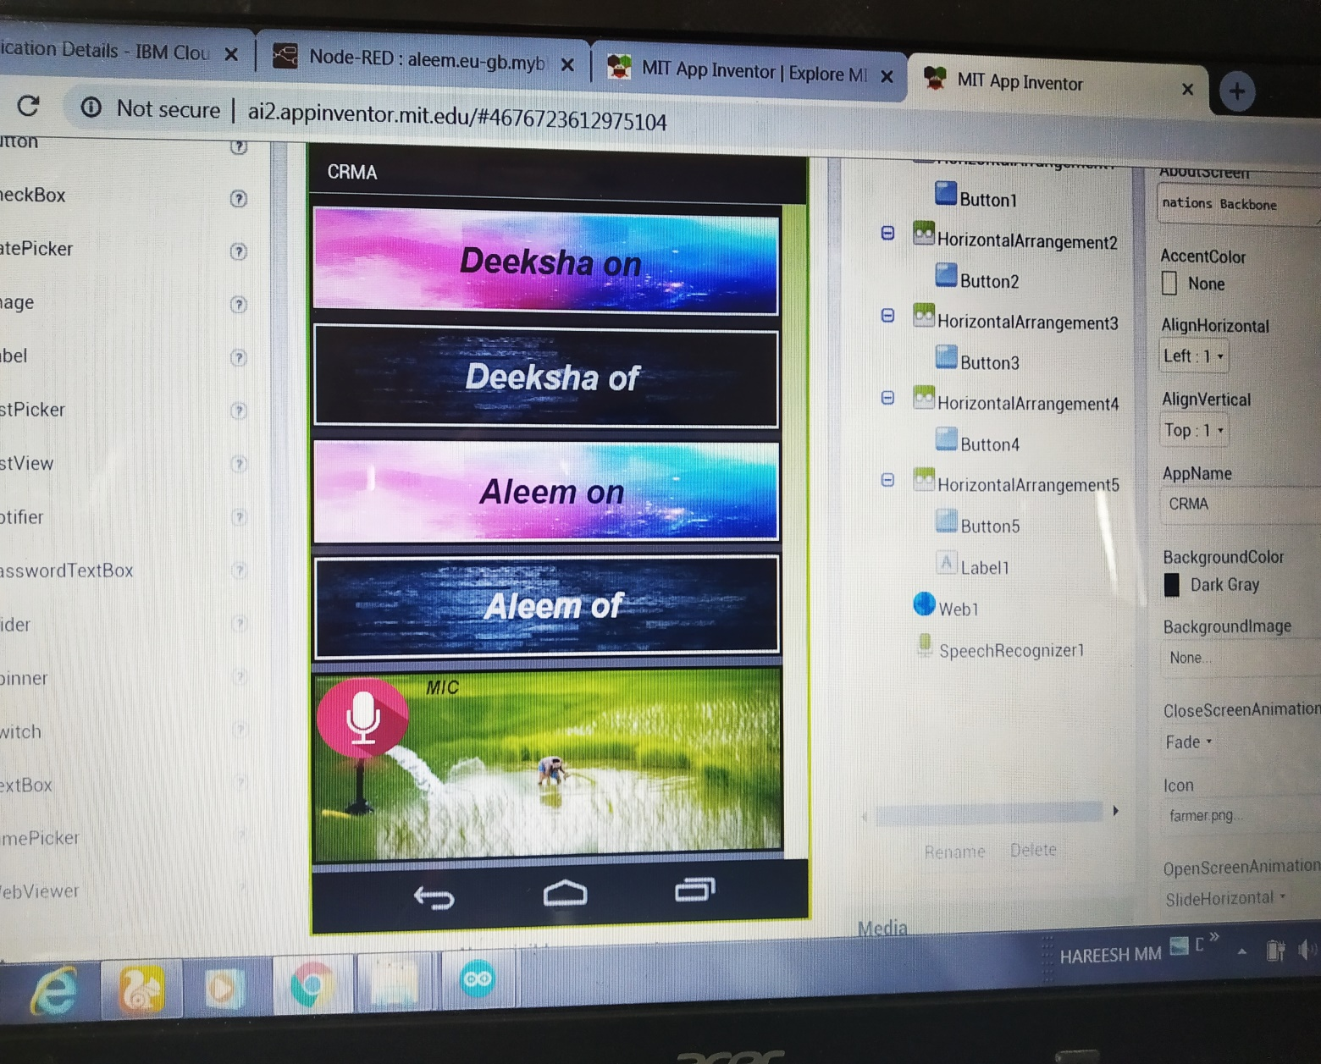
output

Slide 10
THANK YOU

